Slide 1
Introduction to Security Goals
Tasneem Mirza

Slide 2
The word security means protection against malicious attack by outsiders (and by insiders) of a system.

Slide 3
3 valuable components of a computer based
system :
Hardware
Software
Data
The ways in which there could be loss /harm to
Information :
Data could be disclosed to unauthorized parties.
Data could be modified in illegitimate ways.
Legitimate users may not have access to the data.

Slide 4
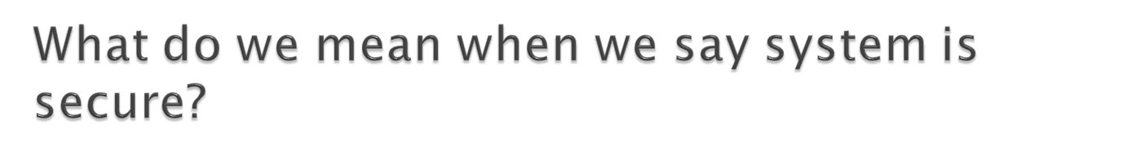
Goals of security :
1. Data should not be disclosed to unauthorized parties.
Confidentiality
2. Data should not be modified in illegitimate ways.
Integrity
3. Data should be accessible to authorized parties at appropriate times.
Availability

Slide 5

Confidentiality
Only authorized people can access protected
data.
Issues relating confidentiality :
Who determines which people are authorized to access the current system?
What is the meaning of accessing the data? The authorized party can access whole database/part of the database?
Can someone who is authorized, disclose those data to other parties?

Slide 6
2. Integrity :
Assets can be modified only by authorized parties.
Modifications includes changing, deleting and creating.
3. Availability :
If a person has legitimate access to a particular set of objects, that access should not be prevented.

Slide 7

A vulnerability is a weakness in the system that might be exploited to cause loss/harm.
A threat is a set of circumstances that has the potential to cause loss/harm.
Eg : An administrator account “admin” with the password “admin” is a vulnerability.
An outsider hence gaining access to sensitive information is a threat.
Vulnerability is a flaw in the system that can
cause a threat.

Slide 8
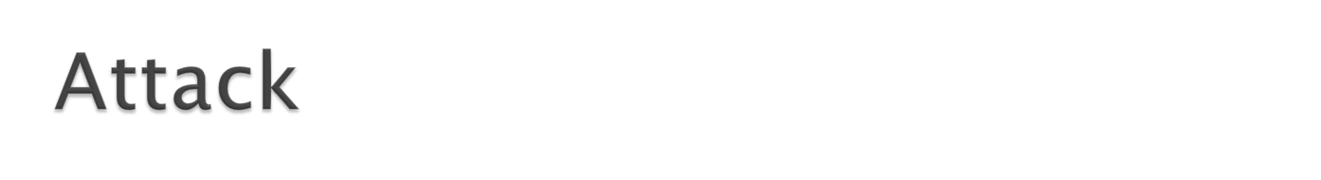
Act that exploits vulnerability.
Difference between threat and attack
Threat can be either intentional /unintentional whereas attack is intentional.
Threat is a circumstance that has potential to cause loss or damage whereas attack is attempted to cause damage.
Threat to the information system doesn’t mean information was altered or damaged but attack on the information system means there might be chance to alter, damage, or obtain information when attack was successful.

Slide 9

Types of threats :
Consider a sender S and a recipient R.
If S entrusts the message to T, who then delivers it to R, then T becomes the Transmission medium.
If an outsider O wants to access the message ( to read, change or destroy it) then O is an interceptor or intruder.
Any time after S transmits it via T, the message is vulnerable to exploitation and O might try to access the message in any of the following ways :

Slide 10

Interruption (Block)
Prevents the message from reaching R, thereby affecting the availability of message.
2. Interception.
Read or listen to the message thereby affecting the confidentiality of the message

Slide 11
3. Modification
  An unauthorized party(O) not only gains access but tampers with an asset
Seizing the message and changing it in some way.
  Changing values in a data file.
  Threatens integrity
  4. Fabrication
  Fabricate an authentic looking message arranging for it to be delivered as if it came from S, thereby affecting the integrity and authentication of the message

Slide 12
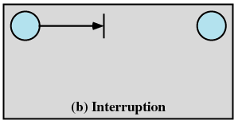
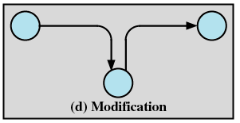
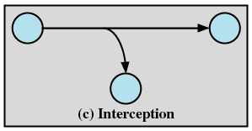
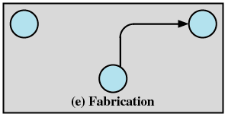
S
R
S
R
O
S
R
S
R
O
O

Slide 13

  Hackers :
  A computer enthusiast as an individual who enjoys
  exploring the details of computers and how to
  stretch their capabilities, as opposed to most users
  who prefer to learn only the minimum necessary.
  Crackers :
  A cracker is one who breaks security on a system.
  Crackers are hardcore hackers characterized more
  as professional security breakers and thieves.

Slide 14
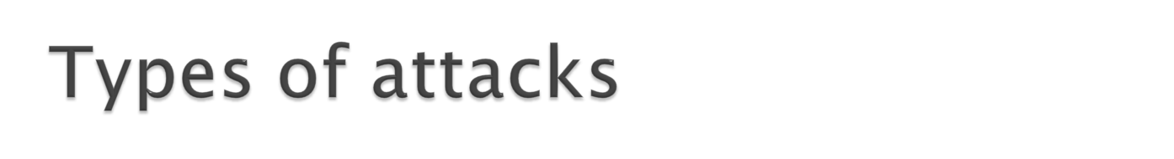
Attacks threatening confidentiality
a) Snooping : refers to unauthorized access or interception of data
Encryption is used to make information nonintelligible to the snooper.
b) Traffic Analysis :
Although the encipherment of data may make it non intelligible for the interceptor, he/she can obtain some other type of information by monitoring the line traffic. Eg: the nature of information (like text or image files) that is transmitted

Slide 15
2. Attacks Threatening Integrity:
a) Modification :
The integrity of data can be threatened by modification.
An attacker can modify the transmitted information, without needing to know the actual content. It could delay or change the content to foil the objective of a transaction.
b) Masquerading:
An attacker can modify the communication data to pretend (spoof) as a legal sender or receiver to obtain the information to which it does not have access.
For example an attacker might steal the bank card and PIN of a bank customer and pretend that he/she is the customer.

Slide 16
c) Replaying
The attacker obtains a copy of the message sent by a user and later tries to replay/send it.
For example: A person sends a request to his bank to ask for payment to the attacker, who had done a job for him. The attacker intercept the message and sends it again to cause another payment from the Bank.
d) Repudiation
The sender of the message might later deny that he/she has sent the message and the receiver of the message might deny that he has received the message.
An example of denial by sender would be a bank customer asking her bank to send some money to a third party but
later denying that he had made such a request.

Slide 17
An eg. of denial by receiver could occur when a person buys from a manufacturer and pays electronically, but the manufacturer later denies having received the payment and asks to be paid.
3. Attacks threatening availability:
Denial of service
It is a very common attack.
It may slow down or totally interrupt the service of a system.
The attacker can use several strategies to achieve this. He might send so many bogus requests to a server that the server crashes because of the heavy load. Hence service is not available to the client.

Slide 18

Passive attack:
A benign kind of attack, that means, that the
eavesdropper or the attacker does not modify
or delete the information, but just receives
the information and observes the content.
Active attack:
The attacker actually modifies or deletes or
inserts information, therefore , it is a
potentially more harmful kind of attack

Slide 19
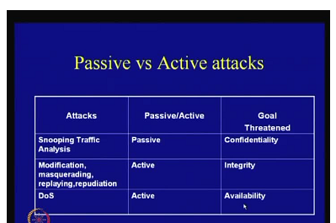

Slide 20

Six security services
1: Data confidentiality :
The protection of data from unauthorized
disclosure.
2. Data integrity :
The assurance that data received are exactly as sent by an authorized entity, i.e. contain
no modification
no insertion
no deletion

Slide 21
3. Authentication :
The authentication service is concerning with
assuring that a communication is authentic.
The recipient of the message should be sure that the message came from the source that it claims to be.
Eg: consider a person, using online banking
service. Both the user and the bank should be
assured of identities of each other

Slide 22
4. Non repudiation :
Protection against denial by one of the entities involved in a
communication of having participated in the communication.
Nonrepudiation can be related to
Origin: proof that the message was sent by the specified party
Destination: proof that the message was received by the specified party
Example
Imagine a user of online banking who has made a
transaction, but later denied that. How the bank can protect
itself in a such situation?

Slide 23
5. Access control :
Provides protection against unauthorized
access to the data.
6. Availability service :
Protects a system to ensure its availability
Particularly, it addresses denial-of-service attacks.

Slide 24
What are the different mechanisms to provide the services ?
Security mechanisms are used to implement security services.
Encipherment
Digital signature
Access Control mechanisms
Data Integrity mechanisms
Authentication Exchange
Traffic Padding
Routing Control
Notarisation

